Slide 1

Glass Identification
A multi-class classification of glass types
-- Senay Tesfamichael

Slide 2
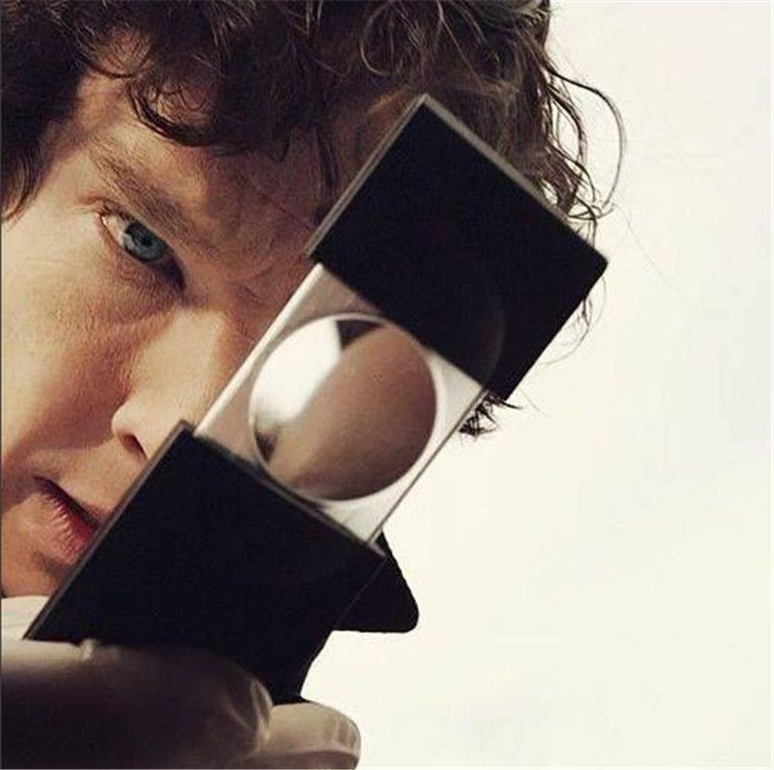
Motivation
Glass fragments are one of the most frequently used items in forensic science.
In most of the crime scenes such as house-breaking, even small fragments of the glass attached to the clothes of a suspect would solve the problem.
Using elemental composition and refractive index, we can tell where the glass comes from, even from small glass fragments.
Is it from a house window? car windshield? Bottle?

Slide 3
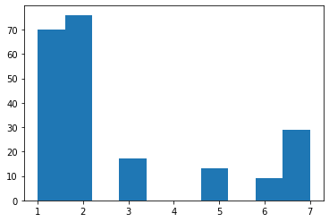
Dataset
Class Distribution
Input Variables:
RI: refractive index
Na: Sodium
Mg: Magnesium
Al: Aluminum
Si: Silicon
K: Potassium
Ca: Calcium
Ba: Barium
Fe: Iron
Types of Glass:
Class 1: building windows (float processed)
Class 2: building windows (non-float processed)
Class 3: vehicle windows (float processed)
Class 4: vehicle windows (non-float processed)
Class 5: containers
Class 6: tableware
Class 7: headlamps
Out of 214 examples:
Class 1: 70 examples
Class 2: 76 examples
Class 3: 17 examples
Class 4: 0 examples
Class 5: 13 examples
Class 6: 9 examples
Class 7: 29 examples
Notes:
The chemical compositions are measured as the weight percent in corresponding oxide.

Slide 4
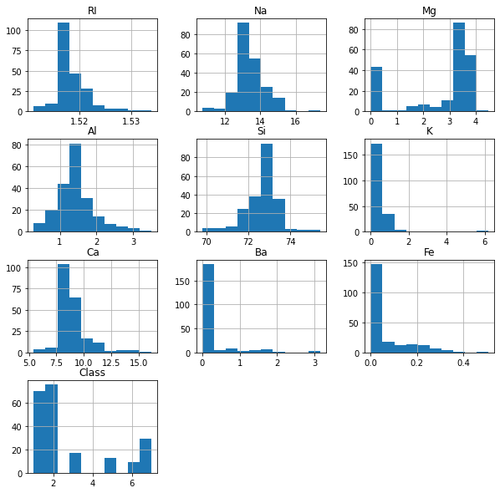
Distribution of Input variables
Range of Ba feature: (0,3.15)
Range of Si feature: (69,75)
Scaling is needed depending on algorithm
Oversampling to handle imbalanced data

Slide 5
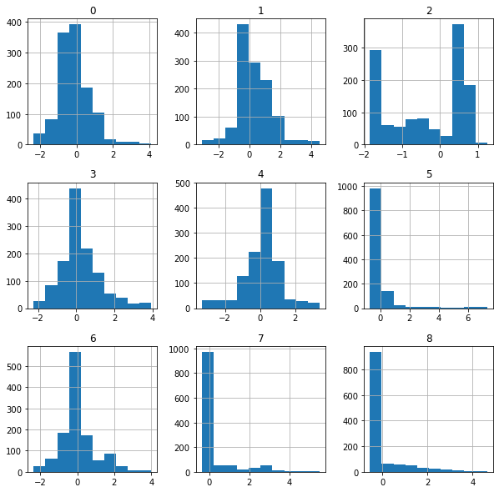
Data Preprocessing
Scikit-learn’s StandardScaler
Split to Training(143) and Test(71) [Stratified]
Oversample the training data using SMOTE Oversampling to include 200 samples per class
1200 samples of balanced data

Slide 6
Model Evaluation
List of Models:
Logistic Regression
SVM
KNN
Decision Tree
Random Forest
ANN
We will implement:
Hyperparameter tuning using GridSearchCV
Repeated Stratified K-Fold Cross validation (K=10, 10 repeats)
For ANN, run for 100 epochs with validation split of 0.33
Baseline: 35% (Predicting class 2 for every sample)
Notes:
LM: params = {'penalty':('l1', 'l2'),'tol':[1e-4,1e-3],'C':[1.0,3.0,5.0],
'class_weight':('balanced',None),'solver':('newton-cg', 'lbfgs', 'liblinear'),'multi_class':('auto', 'ovr', 'multinomial’)}
Knn:params = {'n_neighbors':[1,2,3,4,5,6,7,8,9,10],'weights':('uniform','distance'),
'algorithm':('auto', 'ball_tree', 'kd_tree', 'brute’),
Svm:params = {'C':[1.0,1.5,2.0,2.5,3.0,4.0,5.0],'kernel':('linear', 'poly', 'rbf', 'sigmoid'),
'gamma':('scale','auto'),'decision_function_shape':('ovo', 'ovr’)}
DecisionTree: params = {'criterion':('gini', 'entropy'),'splitter':('best', 'random'),'max_depth':[10,50,100,500,1000],
'min_samples_split':[1,2,5,10],'min_samples_leaf':[1,2,3,5],'max_features':('auto','sqrt','log2',None)}
RF: params = {'n_estimators':[1,10,100,1000],'max_depth':[1,10,100,1000],
'min_samples_split':[1,2],'min_samples_leaf':[1,2],
'class_weight':('balanced', 'balanced_subsample',None)}

Slide 7
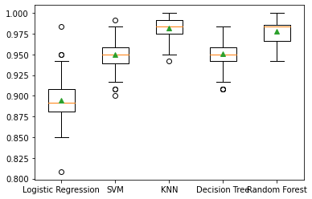
Results
Cross Validation mean accuracy
Logistic Regression: 0.895
SVM: 0.949
KNN: 0.982
Decision Tree: 0.95
Random Forest: 0.978
Evaluating the models on unseen test data
Fit the model on the oversampled training data (1200 samples)
Predict on test data(71)

Slide 8
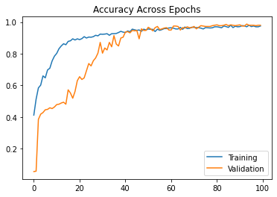
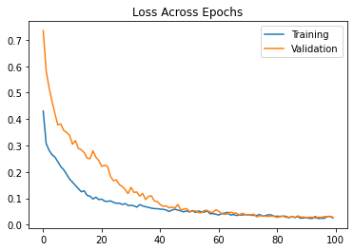
Neural Network
Layout:
Dense(9, Relu)
Dense(512, Relu)
Dropout(0.5)
Dense(256, Relu)
Dropout(0.5)
Dense(6, softmax)
Adam optimizer with cross entropy loss

Slide 9
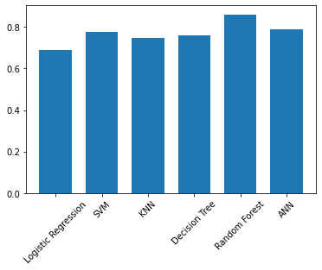
Models’ Performance on Unseen Data
Test set prediction accuracy:
Logistic Regression: 0.69
SVM: 0.775
KNN: 0.746
Decision Tree: 0.761
Random Forest: 0.859
ANN: 0.789

Slide 10
Conclusion
Random Forest performed the most on unseen data with 85% accuracy
For ANN, due to the size of the dataset, the chance of overfitting was higher.
More balanced data collection is needed for better model building and testing

Slide 11
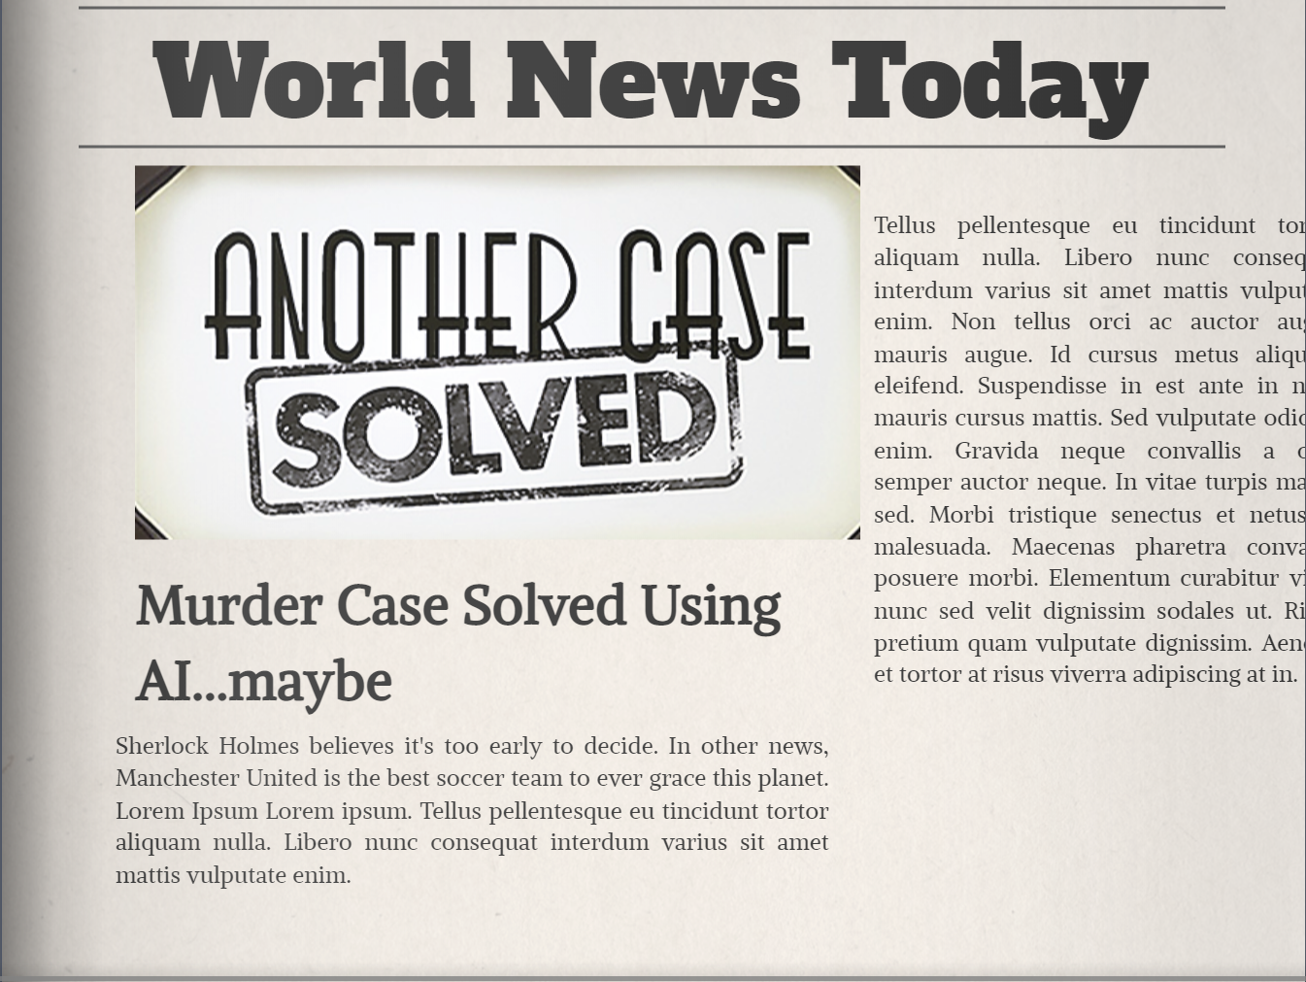
Questions?

Slide 12
References
Dataset: https://archive.ics.uci.edu/ml/datasets/Glass+Identification
Logistic Regression: https://scikit- learn.org/stable/modules/generated/sklearn.linear_model.LogisticRegression.html
SVM: https://scikit-learn.org/stable/modules/generated/sklearn.svm.SVC.html
KNN: https://scikit- learn.org/stable/modules/generated/sklearn.neighbors.KNeighborsClassifier.html
Decision Tree Classifier: https://scikit- learn.org/stable/modules/generated/sklearn.tree.DecisionTreeClassifier.html
Random Forest Classifier: https://scikit- learn.org/stable/modules/generated/sklearn.ensemble.RandomForestClassifier.html
https://machinelearningmastery.com/smote-oversampling-for-imbalanced-classification/
https://amirhessam88.github.io/glass-identification/

